Slide 1
CIS Workshop Scenario

Slide 2
Workshop Scenario Overview
AdventureWorks Travel provides concierge services for business travelers.
In an increasingly crowded market, they are always looking for ways to differentiate themselves and provide added value to their corporate customers.
They are looking to pilot a web-app that their internal customer service agents can use to provide additional information useful to the traveler during the flight booking process.
They want to enable their agents to enter in the flight information and produce a prediction as to if the departing flight will encounter a 15 minute or longer delay, taking into account the weather forecasted for the departure hour.
In this workshop, attendees will build an end-to-end solution to predict flight delays taking into account the weather forecast.

Slide 3
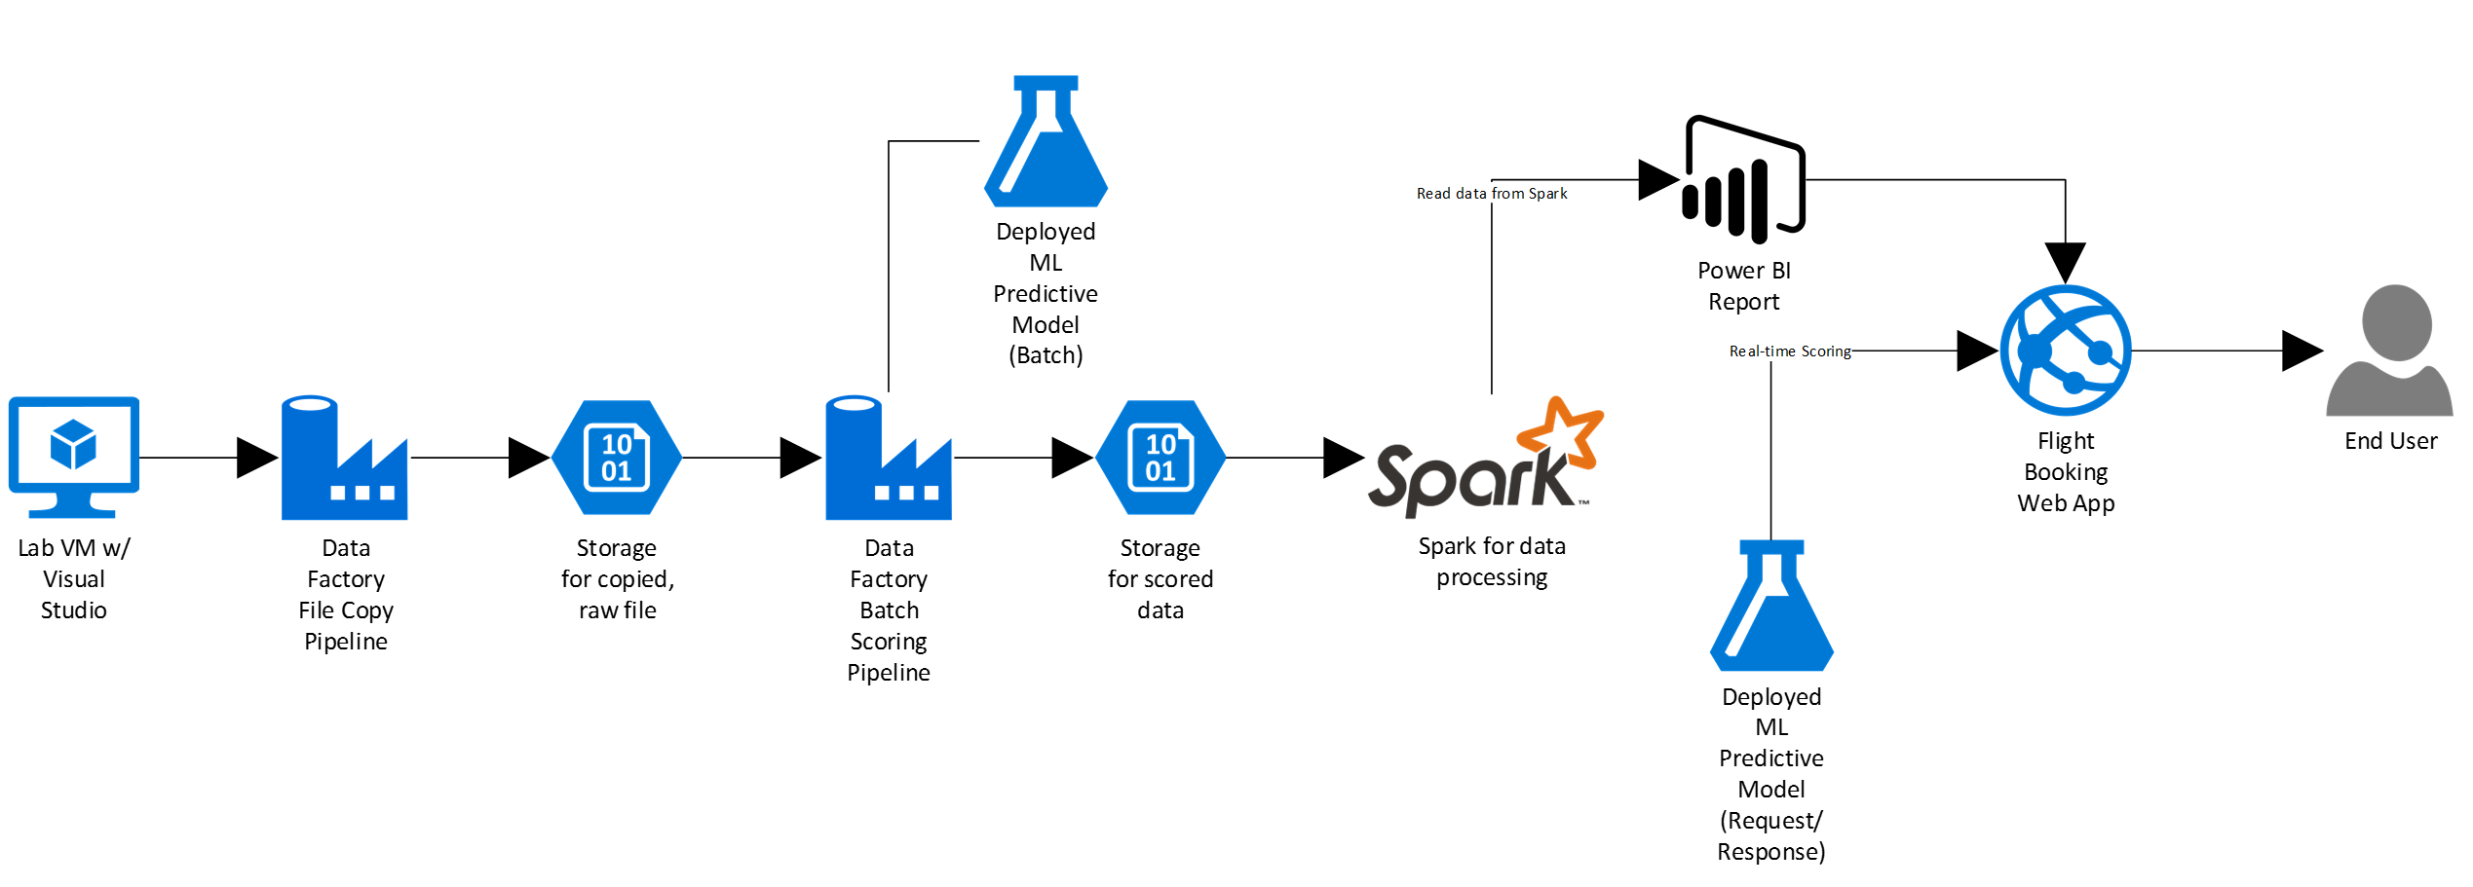
Workshop Architecture
The workshop uses several, but not nearly all, of the components that are part of Cortana Intelligence Suite. The goal is to show an end-to-end solution and not necessarily try to work in every component possible. The workshop architecture is below and includes:
Azure ML
Azure Data Factory
Azure Storage
HDInsight Spark
Power BI
Azure App Service

Slide 4
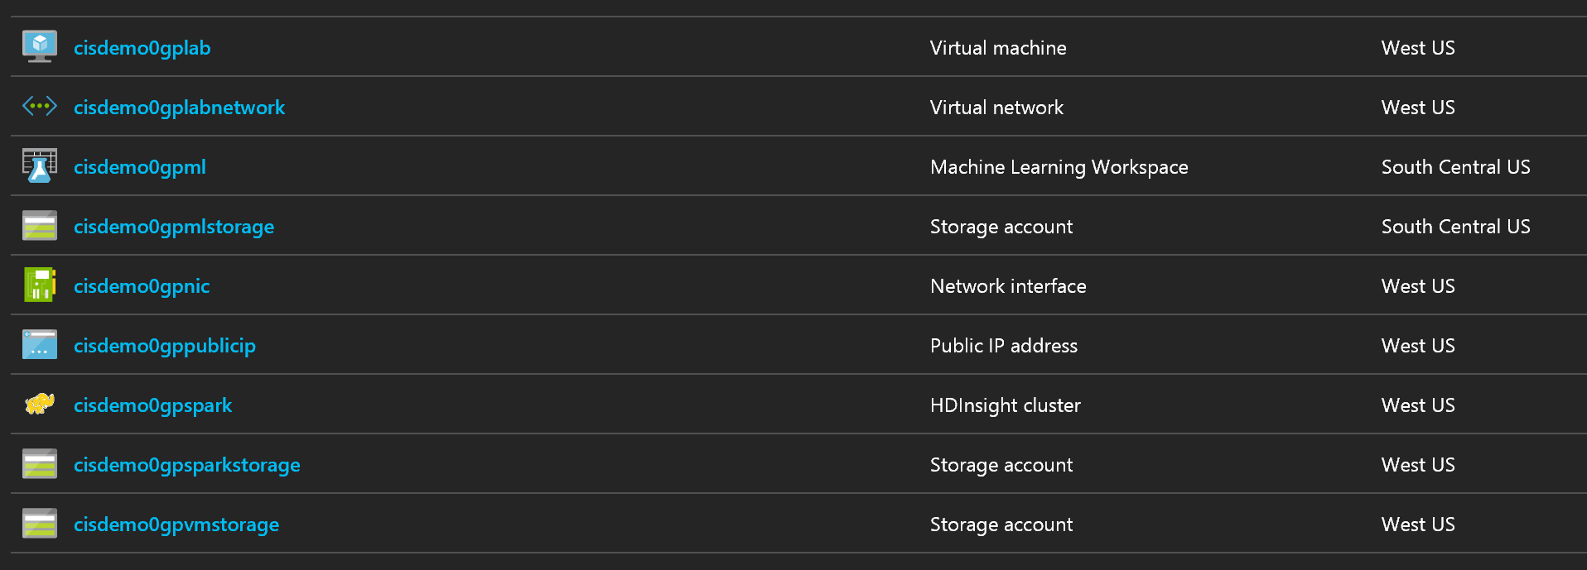
Before you start workshop
Deploy Workshop Environment to Azure
Visit following link and deploy test/dev environment
It might take 15 minutes BUT you can connect to Virtual Machine during the resource group provision status.
Further lab will be
Find a virtual machine and connect to it using following credential
http://bit.ly/2j1eDSV
ID | Password
cortana | Password.1!!

Slide 5
Before you start workshop
What is happening?

Slide 6
Before you start workshop
Make sure you are working in the VM you created

Slide 7
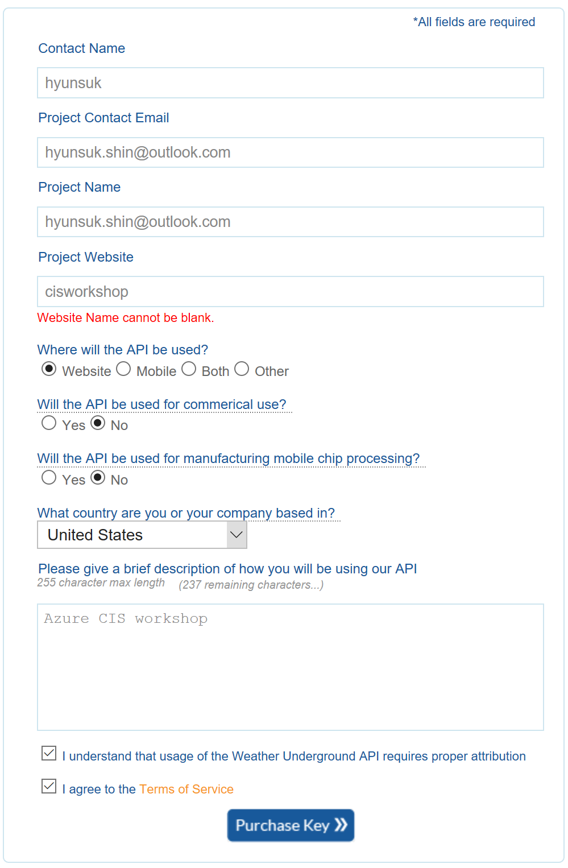
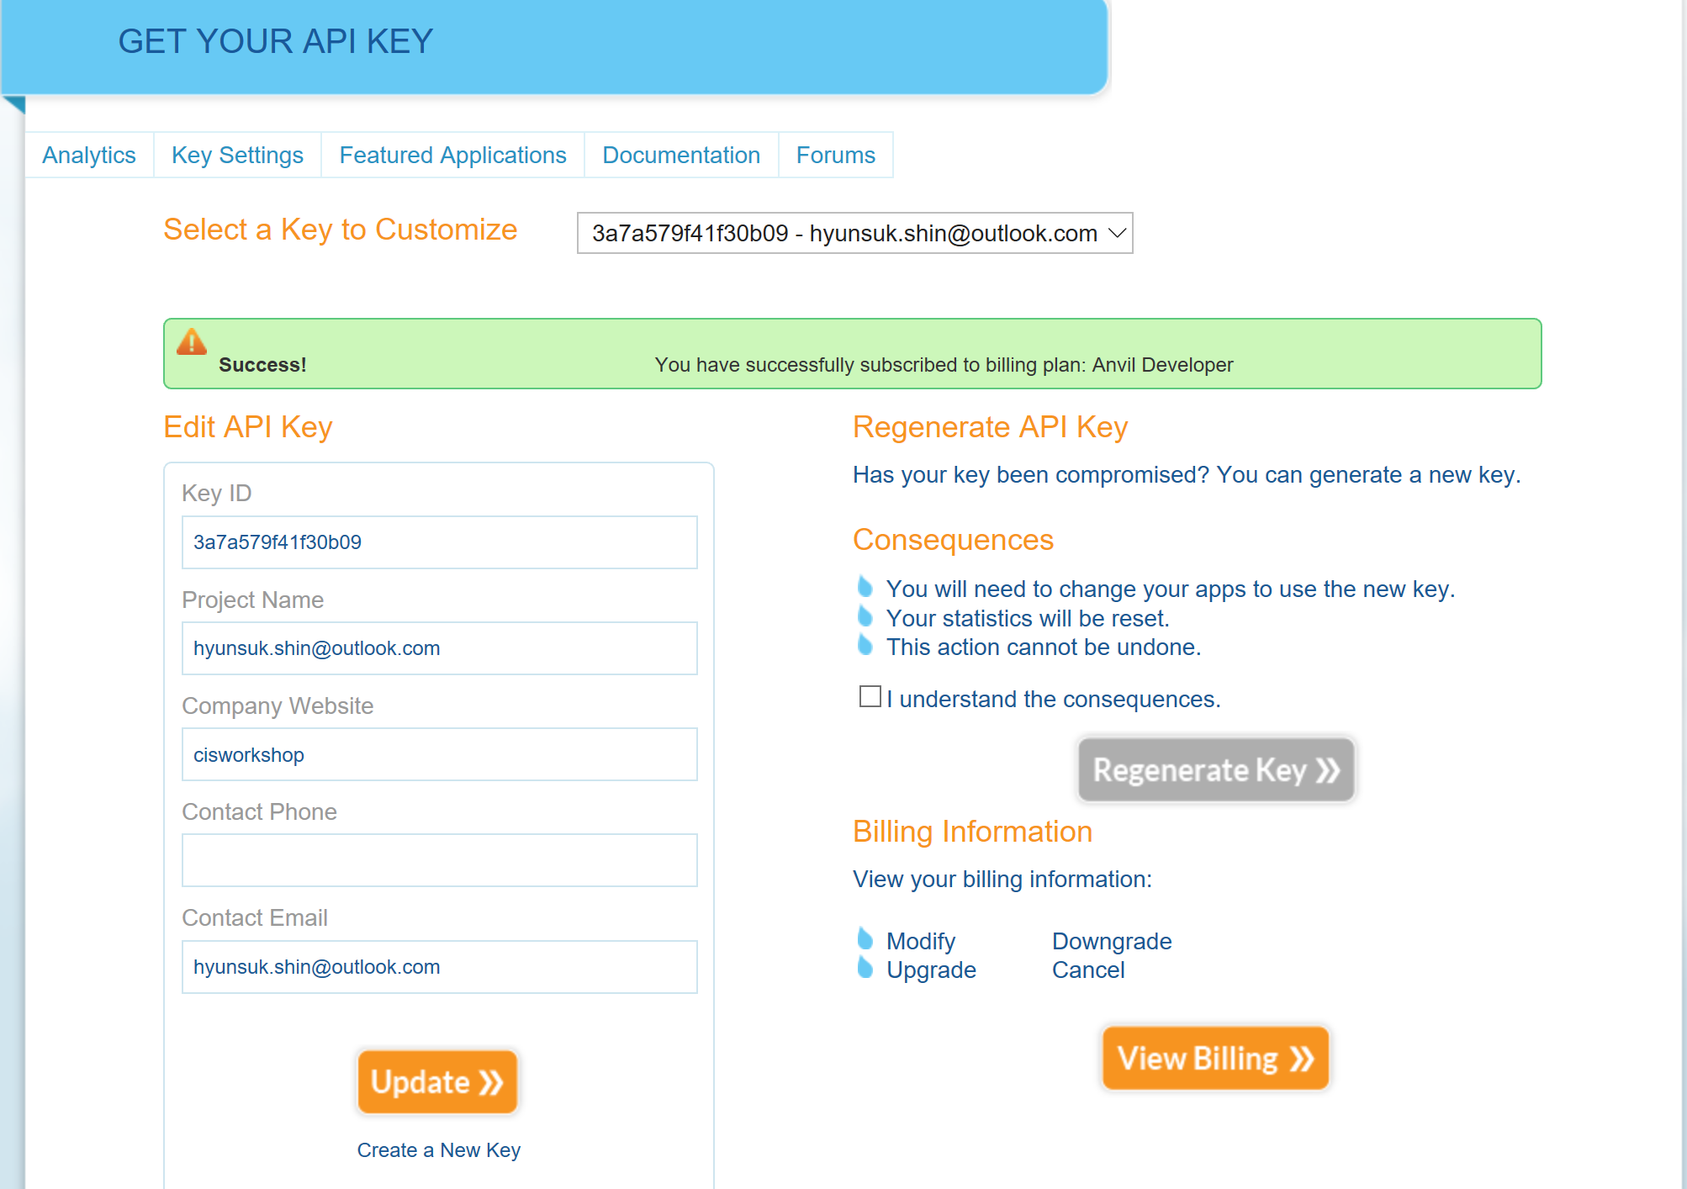
Acquire Weather Underground API Key
http://api.wunderground.com/api/3a7a579f41f30b09 /forecast10day/q/WA/SEA.json

Slide 8
Workshop Manuals
Make your workshop easy
http://bit.ly/2jjzBfl
User name: cortana
Password: Password.1!!

Slide 9
Ex 1: Building a Machine Learning Model
What you will see next.

Slide 10
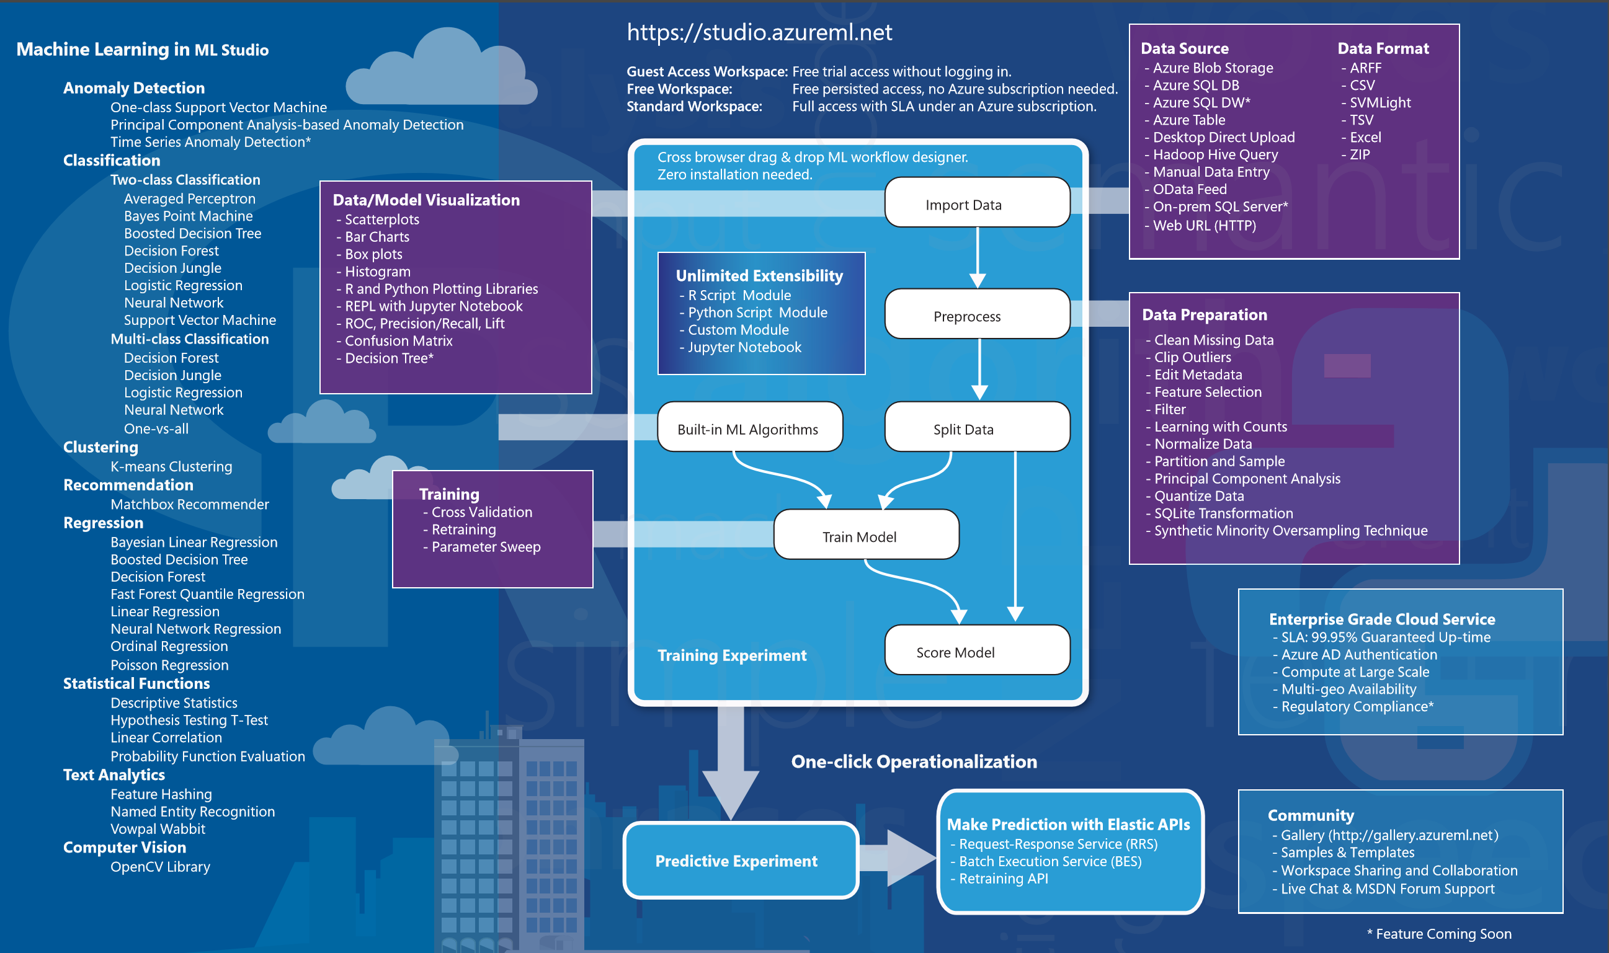
Azure Machine Learning Studio

Slide 11
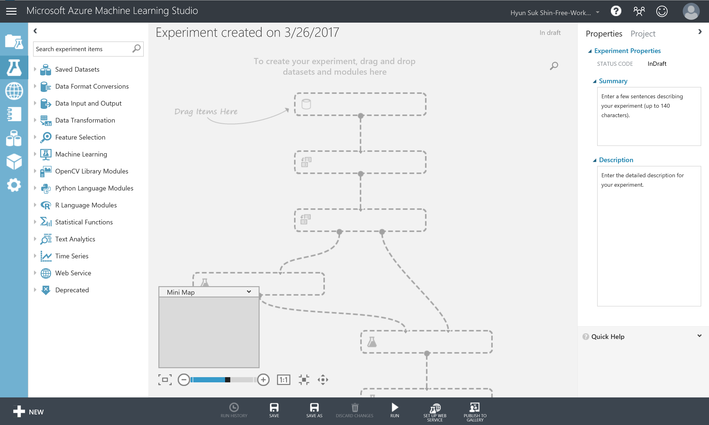
Azure Machine Learning Studio

Slide 12
Exercise 1: Building a Machine Learning Model
Understanding Flight Delays Data Set
A flight is counted as on time if it operated less than 15 minutes later the scheduled time shown in the carriers' Computerized Reservations Systems (CRS). Arrival performance is based on arrival at the gate. Departure performance is based on departure from the gate. Source: Bureau of Transportation Statistics.
Before start implementing this experiment
Departure or Arrival Date is in HHMM format. So to round any the closest hour, we will divide it by 100 and then round the result (using floor() math operation) to get the integer number of a given number. For example: 1135. We will apply divide op.: (1135/100) = 11.35, then round op. using Floor(11.35) = 11.
Categorical Variables are those that represent a fixed number of possible values, rather than a continuous number. In this experiment, the columns Carrier, OriginAirportID, and DestAirportID represent categorical attributes.
Binning or grouping data (some time called quantization) is an important tool in preparing numeric data for machine learning. In this experiment, we are using group data into bins using Quantiles binning mode. Quantiles is also known as equal Hight binning. This applies to all numeric values in selected flight delays dataset.
In this experiment, we used sweep parameters (Tune Model Hyperparameter): Performs a parameter sweep on a model to determine the optimum parameter settings.
In this experiment, we used AUC as a metric for measuring performance for classification.

Slide 13
Ex 2: Setup Azure Data Factory

Slide 14
Ex 2: Setup Azure Data Factory
Upload data in side of your organization to Azure for analysis

Slide 15
Ex 3: Develop Data Factory Pipeline for Data Movement

Slide 16
Ex 4: Operationalize ML Scoring with Azure ML and Data Factory

Slide 17
Ex 5: Summarize Data Using HDInsight Spark
What you will see next.

Slide 18
HDInsight
Microsoft Azure offers managed Hadoop cluster
Provision Hadoop cluster on Azure Portal

Slide 19
Ex 5: Summarize Data Using HDInsight Spark
ID and Password
User name: cortana
Password: Password.1!!

Slide 20
Ex 6: Visualizing in Power BI Desktop
What you will see next.

Slide 21
Ex 7: Deploy Intelligent Web App
What you will see next.

